Slide 1
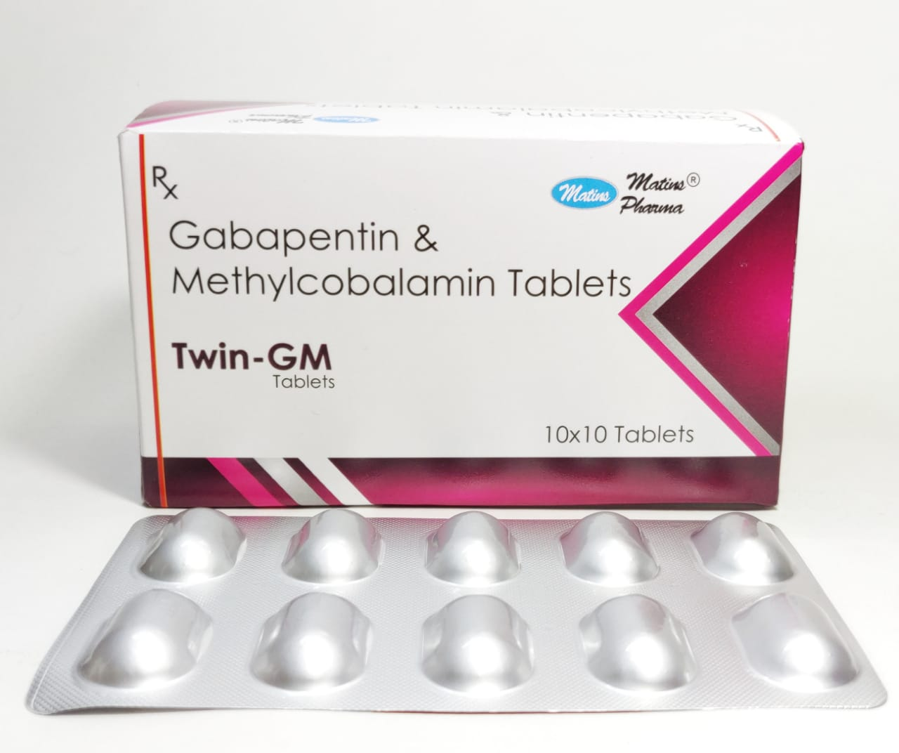
TWIN GM TABLETS
www.matinspharma.com
SALT COMPOSITION
Gabapentin (300mg) + Methylcobalamin (500mcg)

Slide 2
INTRODUCTION of TWIN GM
www.matinspharma.com
TWIN GM Tablet is a combination medicine used for the treatment of neuropathic pain. This medicine decreases pain by modulating calcium channel activity of the nerve cells. TWIN GM Tablet is taken by mouth with or without food, preferably at bedtime. It is advised to take medicine at the same time each day as this helps to maintain a consistent level of medicine in the body. Take this medicine in the dose and duration advised by your doctor. If you miss a dose of this medicine, take it as soon as you remember. Finish the full course of treatment even if you feel better. It is important that this medication is not stopped suddenly without talking to the doctor. Some common side effects of this medicine are nausea, peripheral edema, ataxia, blurred vision, fever and nystagmus (involuntary eye movement). It may also cause dizziness and sleepiness, so do not drive or do anything that requires mental focus until you know how this medicine affects you. It is important to inform your doctor if you develop any unusual changes in mood or behavior, new or worsening depression, or suicidal thoughts. Before taking the medicine you should tell your doctor if you are pregnant, planning to become pregnant, or breastfeeding. It can usually be mixed safely with other medicines but some drugs (including antacids and alcohol) do affect the way it works and can increase the chance of side effects.

Slide 3
USES OF TWIN GM TABLETS
www.matinspharma.com
BENEFITS OF TWIN GM TABLET
In Neuropathic pain
TWIN GM Tablet is a combination of medicines used to treat long-lasting (chronic) pain caused by nerve damage due to diabetes, shingles or spinal cord injury. It reduces pain and its associated symptoms such as mood changes, sleep problems, and tiredness. It is thought to work by interfering with pain signals that travel through the damaged nerves and the brain. Using this medicine regularly will improve your physical and social functioning and overall quality of life. It takes a few weeks to work so you need to use it regularly even if you feel it is not doing any good. Once your symptoms have gone you should still keep using the medicine until your doctor advises you to stop.

Slide 4
SIDE EFFECTS OF TWIN GM TABLET
www.matinspharma.com
Most side effects do not require any medical attention and disappear as your body adjusts to the medicine. Consult your doctor if they persist or if you’re worried about them
Common side effects of TWIN GM TABLET
Dizziness
Sleepiness
Tiredness
Uncoordinated body movements

Slide 5
www.matinspharma.com
HOW TO USE TWIN GM TABLET
Take this medicine in the dose and duration as advised by your doctor. Swallow it as a whole. Do not chew, crush or break it. TWIN GM Tablet may be taken with or without food, but it is better to take it at a fixed time.
HOW TWIN GM TABLET WORKS
TWIN GM Tablet is a combination of two medicines: Gabapentin and Methylcobalamin. Gabapentin is an alpha 2 delta ligand which decreases pain by modulating calcium channel activity of the nerve cells. Methylcobalamin is a form of vitamin B which helps in the production of myelin, a substance that protects nerve fibers and rejuvenates damaged nerve cells. Together, they relieve neuropathic pain (pain from damaged nerves).

Slide 6
SAFETY ADVICE
www.matinspharma.com
Alcohol
UNSAFE
TWIN GM Tablet may cause excessive drowsiness with alcohol.
Pregnancy
CONSULT YOUR DOCTOR
TWIN GM Tablet may be unsafe to use during pregnancy. Although there are limited studies in humans, animal studies have shown harmful effects on the developing baby. Your doctor will weigh the benefits and any potential risks before prescribing it to you. Please consult your doctor.
Breastfeeding
SAFE IF PRESCRIBED
TWIN GM Tablet is probably safe to use during breastfeeding. Limited human data suggests that the drug does not represent any significant risk to the baby.
Baby should be monitored for excessive sleepiness and weight gain.

Slide 7
www.matinspharma.com
Driving
UNSAFE
TWIN GM Tablet may decrease alertness, affect your vision or make you feel sleepy and dizzy. Do not drive if these symptoms occur.
Kidney
CAUTION
TWIN GM Tablet should be used with caution in patients with kidney disease. Dose adjustment of TWIN GM Tablet may be needed. Please consult your doctor.
Liver
CONSULT YOUR DOCTOR
There is limited information available on the use of TWIN GM Tablet in patients with liver disease. Please consult your doctor.

Slide 8
Thank You
For More details, please contact –
Matins Pharma
82840 10553
99155 69932
78146 44275
94175 06219
matinspharma@gmail.com
We offer the following in PCD Franchise:
Ortho Product Range
Gynaecology Product Range
Herbal Products Range
Paediatric Product Range
Ophthalmic Product Range
Derma Product Range
Cardiac-Diabetic Product Range

